Slide 1
CPSC 131 Data Structures Concepts
Dr. Anand Panangadan
apanangadan@fullerton.edu

Slide 2
Goals
Graphs
Terminology
Applications
Abstract Data Structure
Two possible implementations
Adjacency list
Adjacency matrix

Slide 3
Graphs
A graph is a pair (V, E), where
V is a set of nodes, called vertices
E is a collection of pairs of vertices, called edges
Vertices and edges are positions and store elements

Slide 4
Graphs
Example:
A vertex: an airport (three-letter airport code)
An edge: a flight route between two airports (mileage of the route)
849
PVD
1843
ORD
142
SFO
802
LGA
337
1743
1387
HNL
2555
1099
LAX
1233
DFW
1120
MIA

Slide 5
Edge Types
Directed edge
ordered pair of vertices (u,v)
first vertex u is the origin
second vertex v is the destination
e.g., a flight
Undirected edge
unordered pair of vertices (u,v)
e.g., a flight route
Directed graph
all the edges are directed
e.g., route network
Undirected graph
all the edges are undirected
e.g., flight network
flight
AA 1206
ORD
PVD
849
miles
ORD
PVD

Slide 6
Applications
Electronic circuits
Printed circuit board
Integrated circuit
Transportation networks
Highway network
Flight network
Computer networks
Local area network
Internet
Web

Slide 7
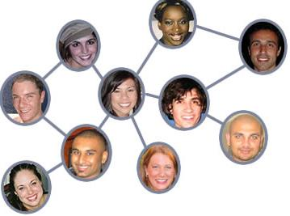
Social network
What are:
Vertices
Edges
Vertex element/label
Edge element/label

Slide 8
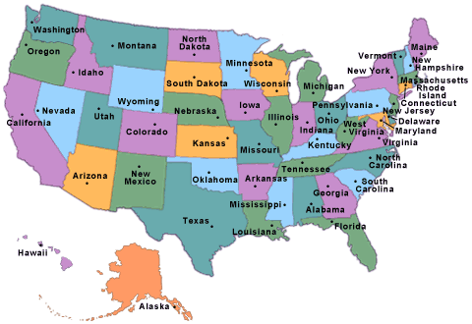
State map
What are:
Vertices
Edges
Vertex element/label
Edge element/label

Slide 9
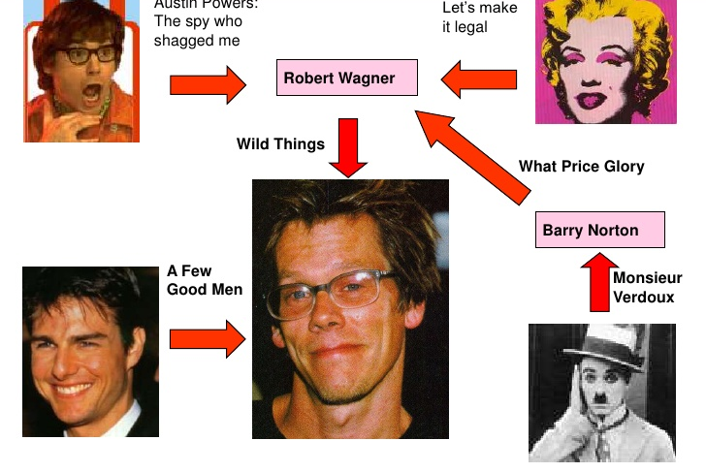
Actor collaboration network
What are:
Vertices
Edges
Vertex element/label
Edge element/label

Slide 10
Terminology
End vertices (or endpoints) of an edge
Endpoints of a?
U and V
Edges incident on a vertex
Incident on V?
a, d, and b
Adjacent vertices
U and V?
U and V are adjacent
U and X?
Degree of a vertex
Degree of X?
X has degree 5
V
a
b
h
U
d
X
Z
c
e
W
g
f
Y

Slide 11
Terminology (cont.)
Path
sequence of alternating vertices and edges
begins with a vertex
ends with a vertex
each edge is preceded and followed by its endpoints
Simple path
path such that all its vertices and edges are distinct
Examples
P₁=(V,b,X,h,Z) is a simple path
P₂=(U,c,W,e,X,g,Y,f,W,d,V) is a path that is not simple
V
a
b
P₁
d
U
X
Z
P₂
h
c
e
W
g
f
Y

Slide 12
Graph Representations
How to represent a graph in a computer program?
Efficiently:
Check if two vertices are adjacent?
List all adjacent vertices of a vertex
Add/remove a vertex to/from the graph
Add/remove an edge to/from the graph

Slide 13
Two representations of a Graph
Adjacency List
Adjacency Matrix

Slide 14
Adjacency List
B
D
Separate list of incident edges for each vertex
A
C
A
B
C
D
B
A
A
A
C
C
B

Slide 15
Property 1
Σ_{v} deg(v) = 2m
Proof: each edge is counted twice
Notation
n number of vertices
m number of edges
deg(v) degree of vertex v
Example
n = 4
m = 6
deg(v) = 3

Slide 16
Property 2
In an undirected graph with no self-loops and no multiple edges
m ≤ n (n − 1)/2
Proof: each vertex has degree at most (n − 1)
Notation
n number of vertices
m number of edges
deg(v) degree of vertex v
Example
n = 4
m = 6
deg(v) = 3

Slide 17
Performance of Adjacency List structure
n vertices, m edges no parallel edges, no self-loops | Adjacency List
Space | O(n + m)
v.incidentEdges() | O(deg(v))
v.isAdjacentTo (w) | O(min(deg(v), deg(w)))
insertVertex(o) | O(1)
insertEdge(v, w, o) | O(1)
eraseVertex(v) | O(deg(v))
eraseEdge(e) | O(1)
vertices() | O(n)
edges() | O(m)
e.isIncidentOn(v) | O(1)
e.endVertices() | O(1)
e.opposite(v) | O(1)

Slide 18
Adjacency Matrix
B
D
2D-array
True when cell myarray[i][j] represents an edge
False for nonadjacent vertices
A
C
A
B
C
D
A
●
●
B
●
●
●
C
●
●
D
●

Slide 19
Comparative performance
n vertices, m edges | Adjacency List | Adj. Matrix
Space | O(n + m) | O(n²)
List adjacent vertices of v | O(n) | O(n)
v.isAdjacentTo (w) | O(n) | O(1)
insertVertex(v) | O(1) | O(n²)
insertEdge(v, w) | O(1) | O(1)

Slide 20
Comparative performance
n vertices, m edges | Adjacency List | Adj. Matrix
Space | O(n + m) | O(n²)
List adjacent vertices of v | O(n) | O(n)
v.isAdjacentTo (w) | O(n) | O(1)
insertVertex(v) | O(1) | O(n²)
insertEdge(v, w) | O(1) | O(1)

